Slide 1
WPD beamformer
Weighted Power minimization Distortionless response BF

Slide 2
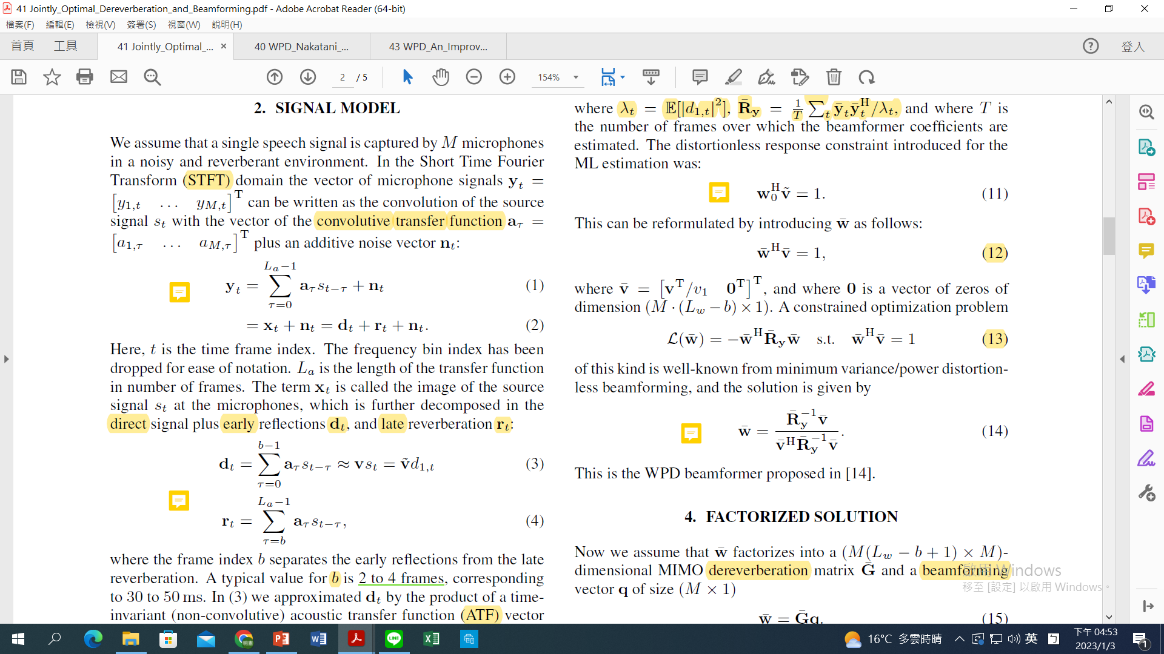

Slide 3
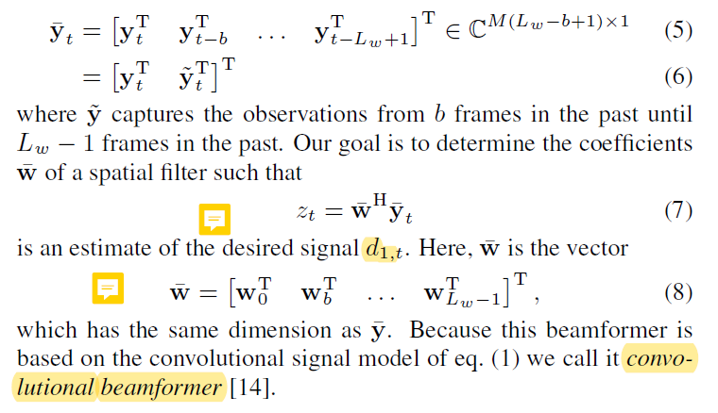

Slide 4
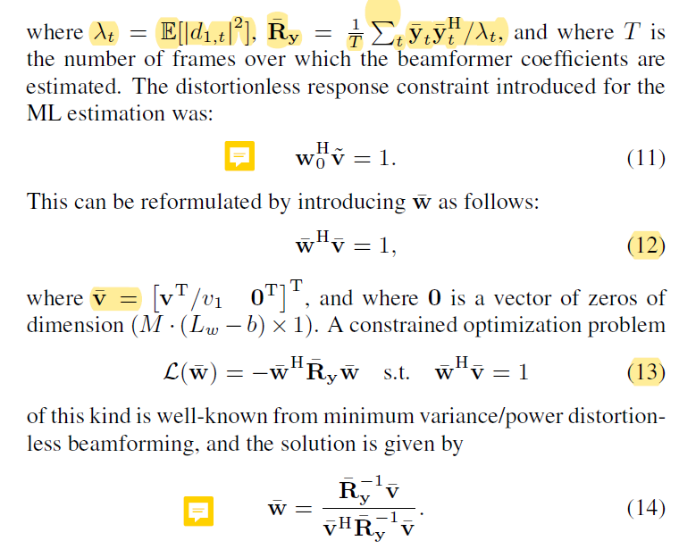

Slide 5
Remarks
MPD is equivalent to MIMO-WPE + wMPDR.
This cascaded solution may have some practical advantages because it allows to treat dereverberation and beamforming separately with parameters learned by NNs.
Learning-based approaches can be exploited to estimate the RTF and the signal power.

